Slide 1
Time Series – Project - EDA
DS 6373 – 403
MSDS Spring 2020

Slide 2
Team - RMustangs
Dhyan Shah
Chandler Vaughn
Entrepreneur with 20 Yrs. experience in Energy, IoT, & Machine Learning
Executive with 20 Yrs. experience in Product Development & Technology

Slide 3

Time Series Description
Who: The Minnesota Department of Transportation
What: Hourly I-94 Westbound traffic volume and weather features and impact on traffic volume in Minnesota
Location: Automatic Traffic Recorder Station 301, midway between Minneapolis and St Paul, MN.
Interval
Hourly data
Period
10/2/2012 to 09/30/2018
Why:
Data helps forecasting traffic patterns.
Provide traffic insights that aids decision making.
Helps allocate resources where needed most.
Improves traffic
management.

Slide 4
Time Series Attributes
Response Attributes
traffic_volume observations (n) = 48204
Numerical
traffic_volume - Hourly I-94 ATR 301 reported westbound traffic volume
temp - Average temperature in kelvin
rain_1h - Rainfall occurred per hours in mm
snow_1h - Snowfall occurred per hours in mm
clouds_all - Percentage of cloud cover
Date & Time
date_time – Hour, Month, Weekday - recorded in CST time
Categorical
holiday - US National and regional/MN State holidays
weather_main - Short textual description of the current weather
weather_description - Longer textual description of the current weather

Slide 5
Stationary / Non-Stationary
Due to the extent of the data we had to review several dimensions of the data to get a feel for stationarity
All data
Last Year
For all views ACF and Spectral Densities (SD) appears homogenous across time
All times ACFs shows dampening sinusoidal and SDs wandering behavior.
As a result, we chose to view months of data to see necessary patterns (next slides)
Last 6 Months
Last 3 Months
ACFs for 1st half vs 2nd half →

Slide 6
Stationary / Non-Stationary
Additional Realizations: Since this is traffic patterns for a specific road, at a specific location, over a specific time frame, it would be impossible to obtain another realization.
Condition 1: There is a clear evidence of cyclical component towards stationarity
Condition 2: Visually we would estimate constant variance.
Condition 3: The ACF shows clear evidence sinusoidal dampening are symmetric across all segment of data.
Last Two Months
We would estimate this to be a stationary timeseries

Slide 7
ACFs and Spectral Densities just to explore
We observe peak at 0.04 in Spectral Density which confirms our intuition of a period of 24 hours = 1/24 = 0.0417
There is also evidence of a peak at 0.2 or 5 hours which appears to be weak.
ACF supports frequency of 24 hours as evidenced by dampened sinusoidal with trough at 12 and rise to 24 on lags
Last One Month

Slide 8
EDA for Weather Attributes

Slide 9
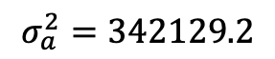
ARMA / ARIMA Model -1
Candidate Model Stationary
ARIMA(3,1)
$$\left(1−2.21 B+1.56 B^{2}−0.341 B^{3}\right){(X}_{t}−3364)={(1−0.87B)a}_{t}$$
BIC: 12.76788
$$σ_{a}^{2}=342129.2$$
ASE: 1501925
Model retains the cyclical behavior.
Residuals

Slide 10
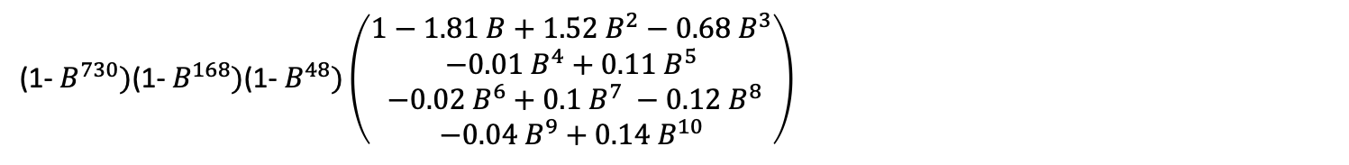
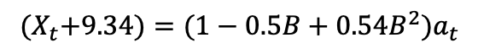
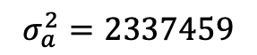
ARMA / ARIMA Model -1
Candidate Model – Seasonal
ARIMA(10,2)
Monthly, Weekly, 48 Hour Differencing
(1- $B^{730})\text{(1− }B^{168})\text{(1− }B^{48})\left(\begin{aligned}1−1.81 B+1.52 B^{2}−0.68 B^{3} \\ −0.01 B^{4}+0.11 B^{5} \\ −0.02 B^{6}+0.1 B^{7} −0.12 B^{8} \\ −0.04 B^{9}+0.14 B^{10}\end{aligned}\right)$
$${(X}_{t}+9.34)={(1−0.5B+0.54B^{2})a}_{t}$$
BIC: 14.71023
$$σ_{a}^{2}=2337459$$
ASE: 1100243
We can confirm the seasonal Monthly, Weekly, 48 Hour Differencing
Residuals

Slide 11
Next Phase Strategy / Analysis plan
Review any outliers and opportunities for imputation
This was largely ignored for this initial analysis,
We plan to explore any opportunities to improve the data quality in next phase.
Testing for other seasonal factors beyond Monthly, Weekly, and 48 Hour cycles
There are likely holiday and time of year factors we plan to include
Incorporate dependent variable into the analysis

